Slide 1

Deep Learning from Scratch Course
Deep Learning from Scratch Course
DAE (IT)
MCS(KU)
MSCS
Instructor of Well-known INTERNATION COMPUTER CENTER

Slide 2




Markov Property
Before understanding the MDP, first understand the Markov Property chain and process...
A Markov chain is a stochastic model describing a sequence of possible events in which the probability of each event depends only on the state attained in the previous event. In continuous-time, it is known as a Markov process. It is named after the Russian mathematician Andrey Markov.
A Markov process is a random process in which the future is independent of the past, given the present. Thus, Markov processes are the natural stochastic analogs of the deterministic processes described by differential and difference equations. They form one of the most important classes of random processes.

Slide 3

Markov Property
The future is independent of the past given the present.”
Once the current state in known, the history of information encountered so far may be thrown away, and that state is a sufficient statistic that gives us the same characterization of the future as if we have all the history.
In mathematical terms, a state St has the Markov property, if and only if;
P[St+1 | St] = P[St+1 | S1, ….. , St],
the state captures all relevant information from history.
For a Markov state S and successor state S′, the state transition probability function is defined by,

Slide 4
Working Example by Example
MDP provide a mathematical framework for modeling decision making in situation where outcomes are partly random and partly under the control of a decision maker.

Slide 5
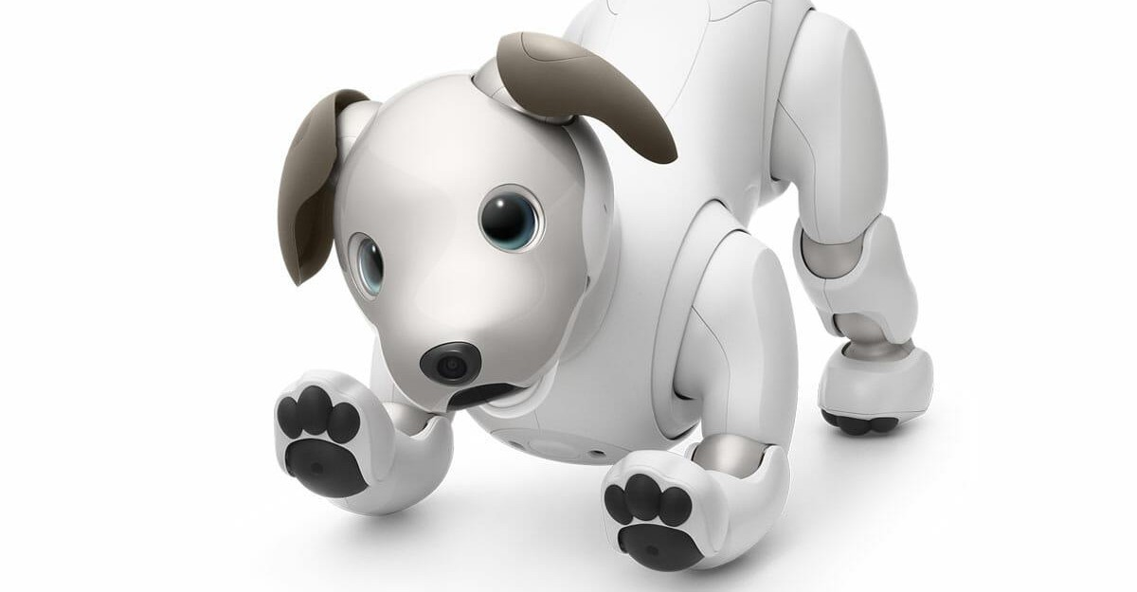
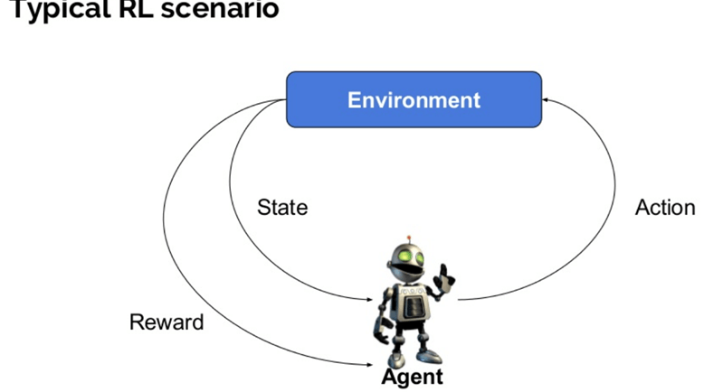
Reinforcement learning
Environment: Physical world in which the agent operates
State: Current situation of the agent
Reward: Feedback from the environment
Policy: Method to map agent’s state to actions
Value: Future reward that an agent would receive by taking an action in a particular state

Slide 6
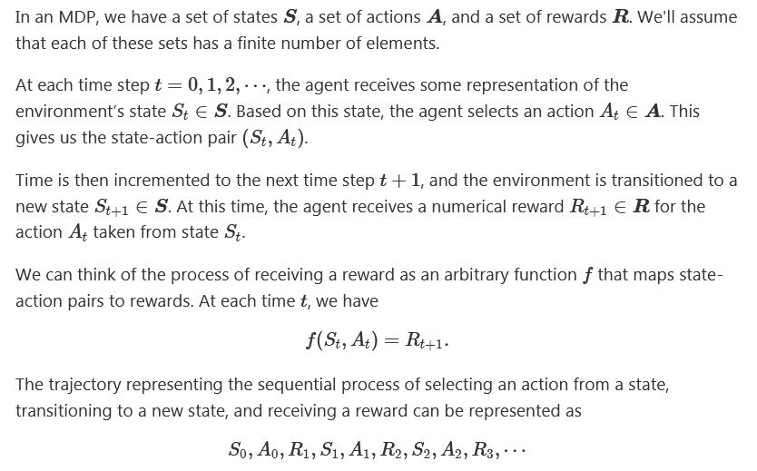
Markov decision process

Slide 7
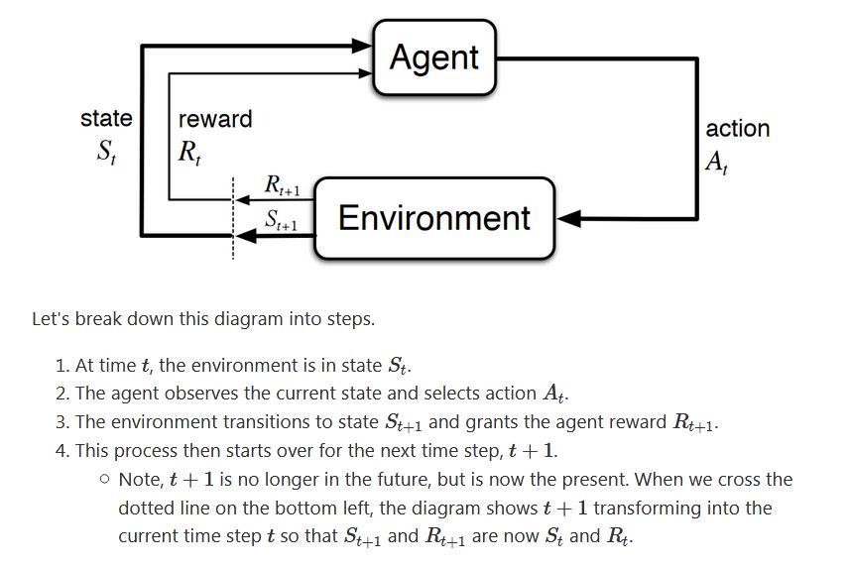
Markov decision process

Slide 8
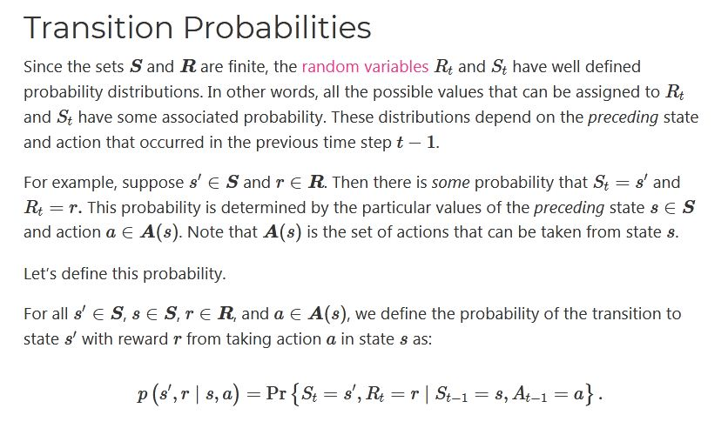
Markov decision process

Slide 9
Hidden Markov model (HMM)
Hidden Markov Models (HMMs) are a class of probabilistic graphical model that allow us to predict a sequence of unknown (hidden) variables from a set of observed variables. A simple example of an HMM is predicting the weather (hidden variable) based on the type of clothes that someone wears (observed)
A hidden Markov model (HMM) is a statistical Markov model
in which the system being modeled is assumed to be a Markov process with unobserved (hidden) states. A HMM can be
considered the simplest dynamic Bayesian network. Hidden Markov models are especially known for their application in temporal pattern recognition such as speech, handwriting, gesture recognition, part-of-speech tagging, musical score
following, partial discharges and bioinformatics.

Slide 10
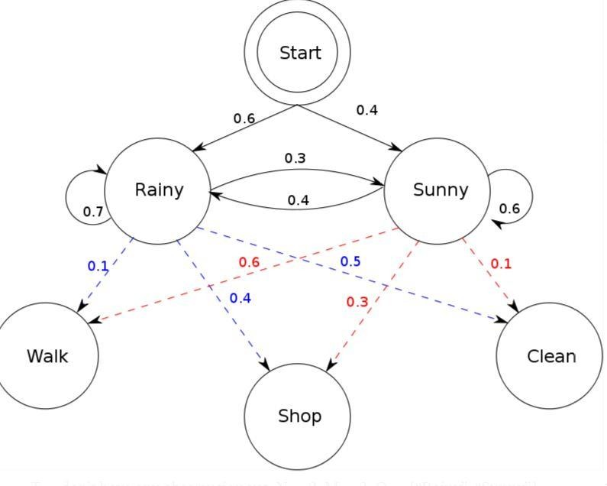
Hidden Markov model (HMM)
The term hidden refers to the first order Markov process behind the observation. Observation refers to the data we know and can observe. Markov process is shown by the interaction between “Rainy” and “Sunny” in the below diagram and each of these are HIDDEN STATES.
Initial Probabilities
Transition Probabilities Emission Probabilities

Slide 11
Thanks
Do Subscribe, like and share ...

Slide 12
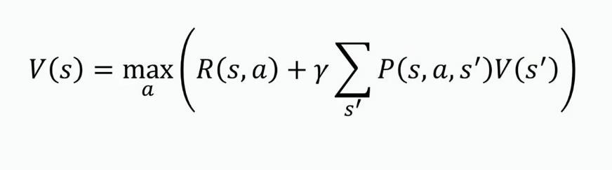
Markov Decision process Bellman Equation
A Bellman equation, named after Richard E. Bellman, is a necessary condition for
optimality associated with the mathematical optimization method known as dynamic
programming.
It writes the "value" of a decision problem at a certain point in time in terms of the payoff from some initial choices and the "value" of the remaining decision problem that results from those initial choices.[citation needed] This breaks a dynamic
optimization problem into a sequence of simpler subproblems, as Bellman's “principle of optimality” prescribes!

Slide 13

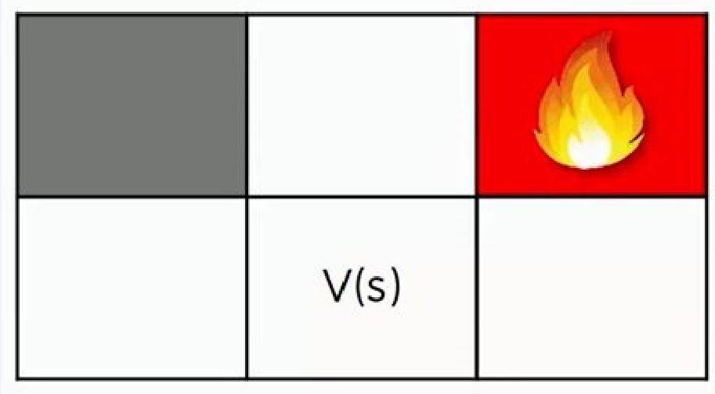

Markov Decision Process Follow the Bellman

Slide 14
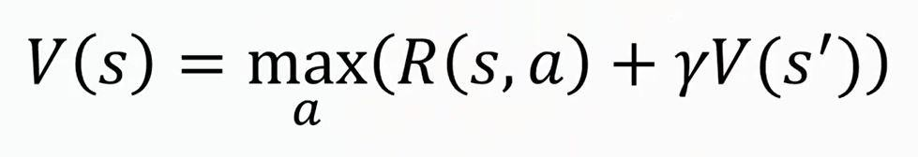
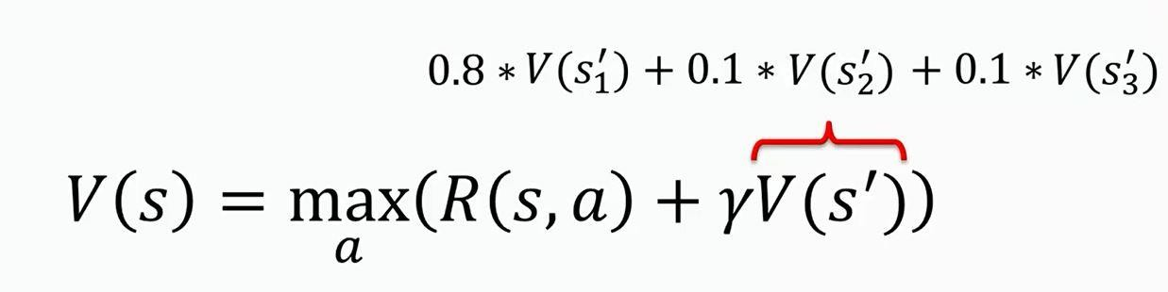


Bellman Equation
Maximum of all possible action Reward acc. To state and action (gamma) Discount value to the next state

Slide 15

Bellman Equation
Finally…

Slide 16
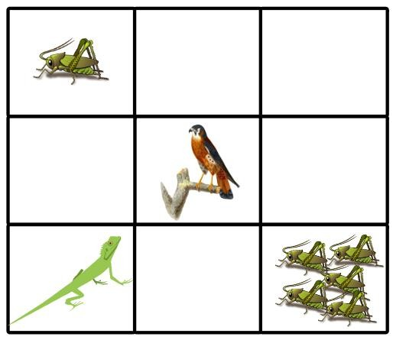
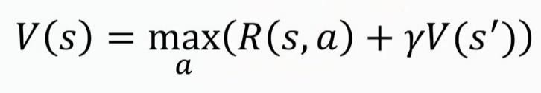
Bellman Equation Practical work

Slide 17
Bellman Equation Practical work

Slide 18
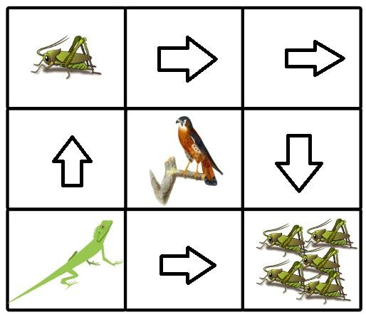

Bellman Equation Practical work

Slide 19
Q Learning
Markov decision processes give us a way to formalize sequential decision making.
It is the agent’s goal to maximize the
cumulative rewards.
Q-learning is one of the technique to find the optimal policy in an MDP. The objective of Q- learning is to find a policy that is optimal in the sense that the expected value of the total reward over all successive steps is the maximum achievable. So, in other words, the goal of Q- learning is to find the optimal policy by learning the optimal
Q-values for each state-action pair.

Slide 20
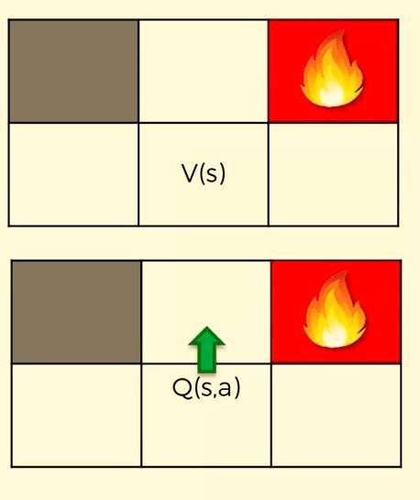
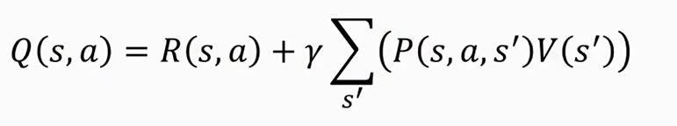
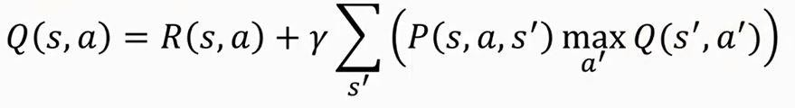
Q Learning

Slide 21
What is SARSA
State–action–reward–state–action (SARSA) is an algorithm for learning a Markov decision process policy, used in the reinforcement learning area of machine learningIt is a technical note with the name "Modified Connectionist Q-Learning" (MCQ-L). The alternative name SARSA, proposed by Rich Sutton, was only mentioned as a footnote.
For Notes and Code:
Visit: http://fahadhussaincs.blogspot.com/

Slide 22
Sarsa
SARSA algorithm is a slight variation of the popular Q-Learning algorithm. For a learning agent in
any Reinforcement Learning algorithm it’s policy can be of two types
On Policy: In this, the learning agent learns the value function according to the current action
derived from the policy currently being used.
Off Policy: In this, the learning agent learns the value function according to the action derived from another policy.
Q-Learning technique is an Off Policy technique and uses the greedy approach to learn the Q- value. SARSA technique, on the other hand, is an On Policy and uses the action performed by the current policy to learn the Q-value.
For Notes and Code:
Visit: http://fahadhussaincs.blogspot.com/

Slide 23
Sarsa
A SARSA agent interacts with the environment and updates the policy based on actions taken, hence this is known as an on-policy learning algorithm. The Q value for a state-action is updated by an error, adjusted by the learning rate alpha. Q values represent the possible reward received in the next time step for taking action a in state s, plus the discounted future reward received from the next state-action observation.
Watkin's Q-learning updates an estimate of the optimal state-action value function Q* based on the maximum reward of available actions. While SARSA learns the Q values associated with taking the policy it follows itself, Watkin's Q-learning learns the Q values associated with taking the optimal policy while following an exploration/exploitation policy.

Slide 24
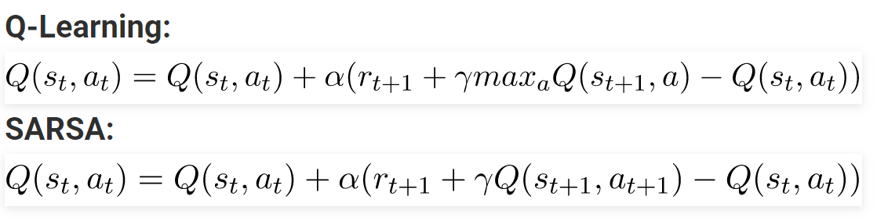
Sarsa
The action a_(t+1) is the action performed in
the next state s_(t+1) under current policy.
Here, the update equation for SARSA depends on the current state, current action, reward obtained, next state and next action. This observation lead to the naming of the learning technique as SARSA stands for State Action Reward State
Action which symbolizes the tuple (s, a, r, s’, a’).
For Notes and Code:
Visit: http://fahadhussaincs.blogspot.com/

Slide 25
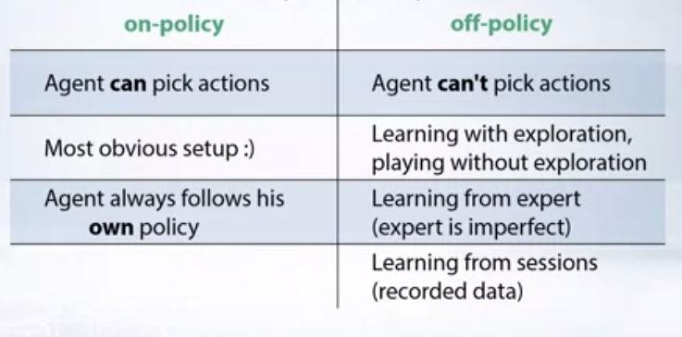
Q Learning VS Sarsa
In Q-Learning, the agent learns optimal policy using absolute greedy policy and behaves using other policies such as ϵ-greedy policy. Because the update policy is different to the behavior policy, so Q-Learning is off-policy.
In SARSA, the agent learns optimal policy and behaves using the same policy such as ϵ-greedy policy. Because the update policy is the same to the behavior policy, so SARSA is on-policy.
For Notes and Code:
Visit: http://fahadhussaincs.blogspot.com/

Slide 26
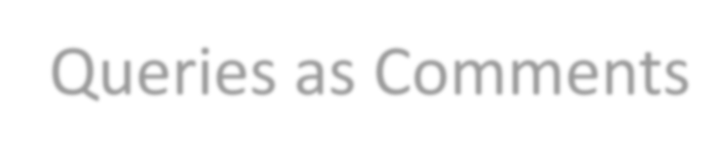
Queries as Comments
Thank You Very Much
For Notes and Code:
Visit: http://fahadhussaincs.blogspot.com/

Slide 27

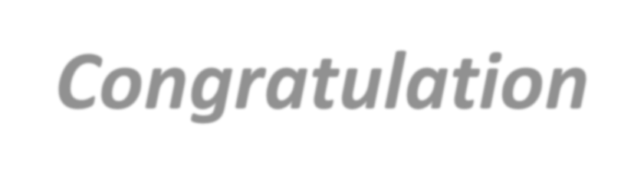
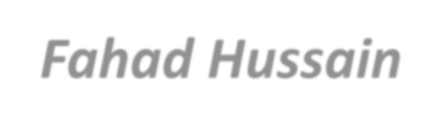
Final words
Congratulation
for completion of DEEP Learning Course
with Fahad Hussain
Supervised UnSupervised and Reinforcement Learning

Slide 28
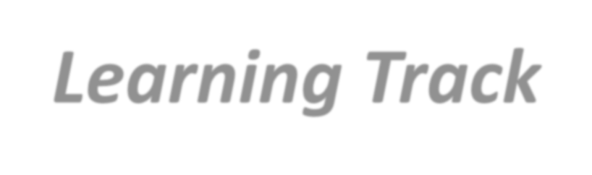
Final words
Learning Track
https://www.youtube.com/channel/UCapJpINJKHz flWwCQ8Kse2g/playlists

Slide 29
Final words
Important Website you must know and read out to be a expert in Machine Learning and Deep Learning.
https://scikit-learn.org/stable/ https://towardsdatascience.com/ https://www.datacamp.com/ https://www.kaggle.com/ https://archive.ics.uci.edu/ml/index.php
https://sci-hub.tw/

Slide 30
Final words
So, What do you think
Its over of Deep Learning,
NO!!!
Actually it is the start of Deep learning Journey
Now,
Join any Company, Org. as internee or Job
To start you career in AI to boost your knowledge practically!!!
Now, the next step is term of Learning
NLP with Deep NLP
Android
Wordpress

Slide 31
Queries as Comments
Thank You Very Much
For Notes and Code:
Visit: http://fahadhussaincs.blogspot.com/

